Slide 1
Free Space Management in Operating System

Slide 2
Free Space Management:
Free space management is a process that tracks unallocated disk blocks to efficiently allocate memory for new files and reuse space from deleted files.
To reuse the space released from deleting the files, a free space list is maintained.
This free space list records which blocks are free to prevent overwriting existing files.

Slide 3
It is not easy work for an operating system to allocate and de-allocate memory blocks (managing free space) simultaneously.
The operating system uses various methods for adding free space and freeing up space after deleting a file.
There are various methods using which a free space list can be implemented:-
Bit vector or Bit map
Linked List
Grouping
Counting

Slide 4
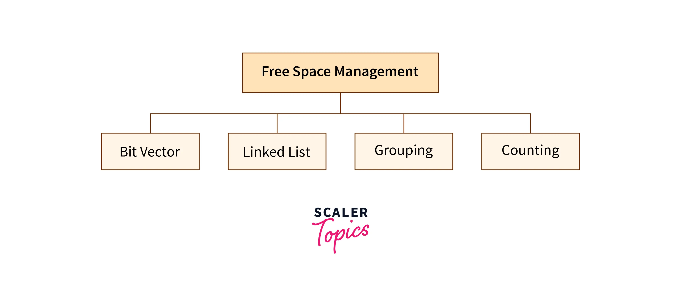

Methods of Free Space Management:

Slide 5
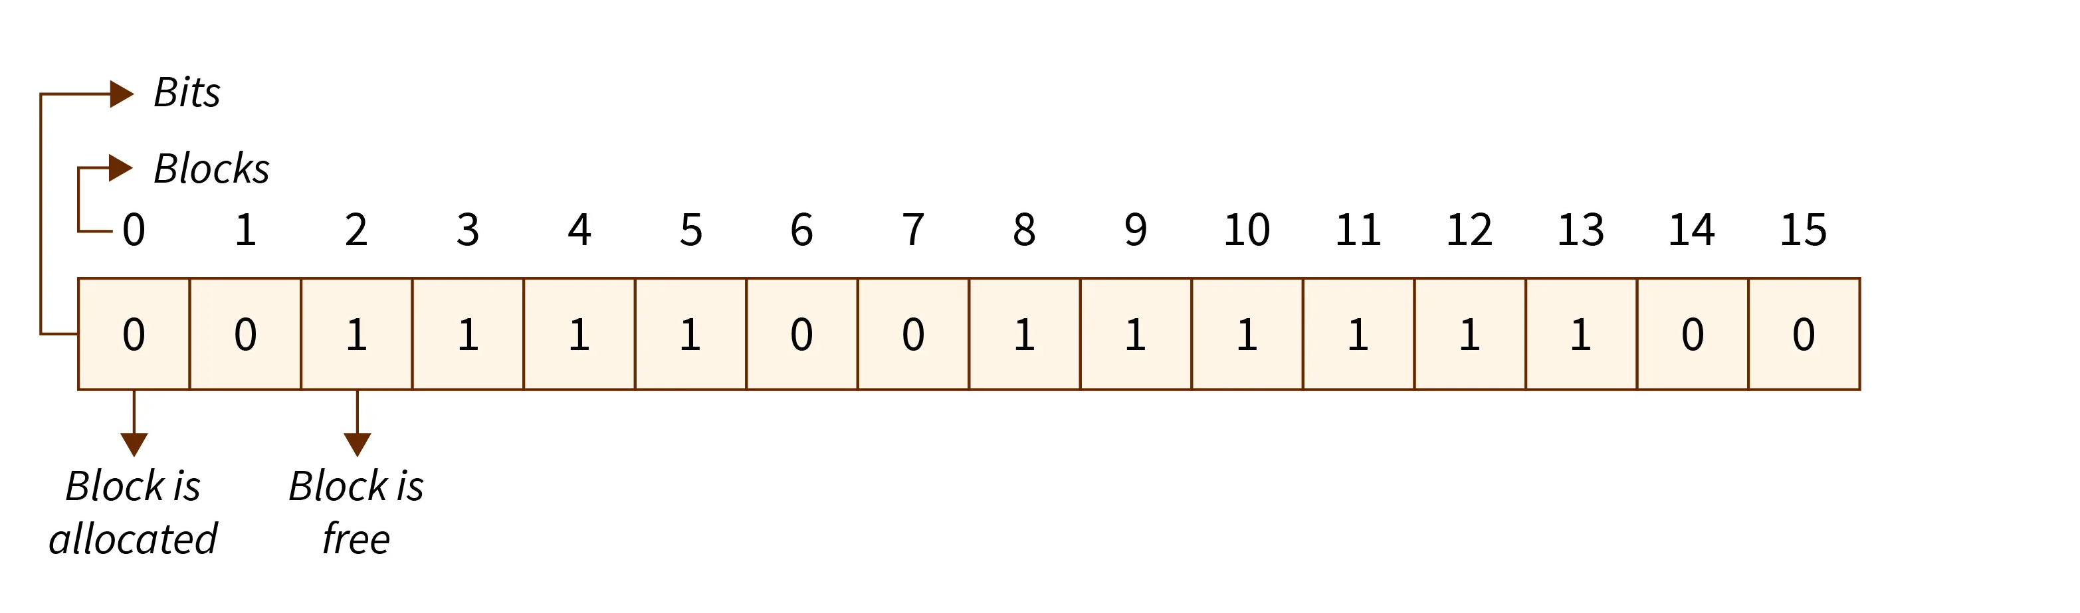
Bit Vector or Bit Map:
A bit vector is a most frequently used method to implement the free space list. A bit vector is also known as a Bit map. It is a series or collection of bits in which each bit represents a disk block.
The values taken by the bits are either 1 or 0. If the block bit is 1, it means the block is empty and if the block bit is 0, it means the block is not free.

Slide 6
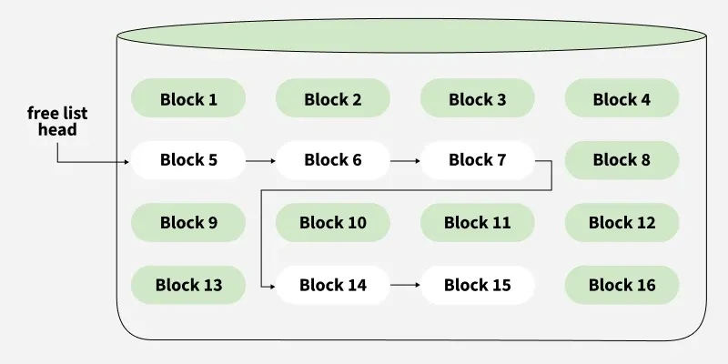
Linked List Method:
In this approach, Free blocks are linked together in a list. Each free block stores the address of the next free block.
The list is maintained dynamically as blocks are allocated and freed.

Slide 7
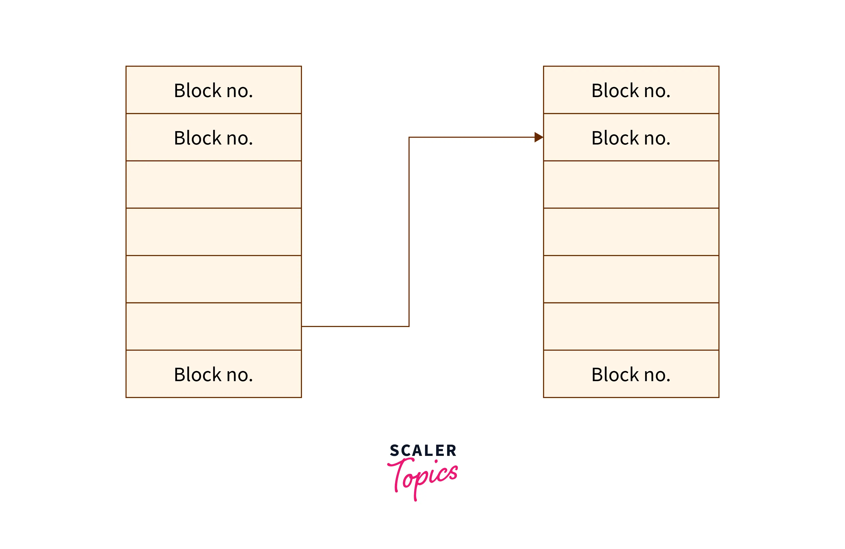
Grouping Method:
The grouping technique is also called the "modification of a linked list technique".
In this method, first, the free block of memory contains the addresses of the n-free blocks. And the last free block of these n free blocks contains the addresses of the next n free block of memory and this keeps going on.

Slide 8
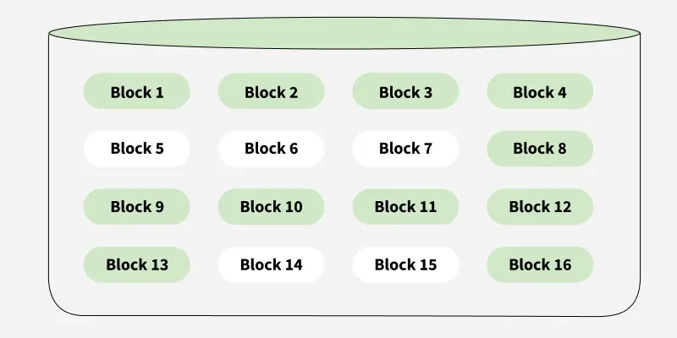
Counting Method:
Creation of files occupy free blocks and deletion of file frees blocks. When there is an entry in the free space, it consists of two parameters- "address of first free disk block (a pointer)" and "a number 'n'".

Slide 9
Advantages
Efficient Use of Storage Space: These techniques ensure optimal utilization of available space on hard disks and other secondary storage devices, minimizing wastage.
Ease of Implementation: Some methods, like linked allocation, are straightforward and require minimal overhead in terms of processing and memory resources.
Faster File Access: Techniques such as contiguous allocation help in reducing disk fragmentation, leading to quicker access times for files and improved system performance.
Disadvantages
Fragmentation: Certain techniques, particularly linked allocation, can lead to fragmentation of disk space, reducing the efficiency of storage operations.
Overhead: Techniques like indexed allocation may introduce additional overhead, necessitating more memory and processing power to maintain structures like index blocks.
Limited Scalability: Some methods, such as the File Allocation Table (FAT), may not scale well, limiting the number of files that can be efficiently managed on the disk.
Risk of Data Loss: In methods like contiguous allocation, if a file becomes corrupted or damaged, it may be challenging to recover the entire data, leading to potential data loss.

Slide 10
Conclusion:
Free Space Management in an operating system is used to keep track of free spaces to allocate and de-allocate memory blocks to files.
These space blocks are manipulated when there is a creation or deletion of a file in our system.
There are various approaches for free space management in os:
Bit vector
Linked List
Grouping
Counting
All these methods can be used for manipulating files in memory spaces.

